Slide 1
CS 595 DATA VISUALIZATION PROJECT
Topic:
To study the production of major crops in various
states of India in the last 50 years(from 1966 to 2017) and visualize some pattern
between them.
By Akshat Jain
Roll no. 204161003

Slide 2
Motivation
Agriculture is the most important sector of Indian Economy. Indian agriculture sector accounts for 18 per cent of India's gross domestic product (GDP) and provides employment to 50% of the countries workforce.
Despite this,it is considered highly inefficient, wasteful, and incapable of solving the hunger and malnutrition problems.
The use of modern technology such as automated machines, crop sensors, etc. can significantly improve the agriculture sector.

Slide 3
Dataset Source: http://data.icrisat.org/dld/src/crops.html ICRISAT-District Level Data.csv
Sector: Agriculture
Sub-sector: Crops production
Target states/UTs: 20 major states

Slide 4
Answering the following questions
1. states which contribute to maximum crop production in quantity for year 2017
2. states which have maximum agricultural land for producing crops
3. comparing the production of crops from 1966 to 2017
4. comparing the area under production from 1966 to 2017
5. relation between quantity of production and area of production
6. crops which are produced in maximum quantity
7. crops which are grown in maximum area and analysing their trend,discussing on ways to improve the agriculture sector

Slide 5
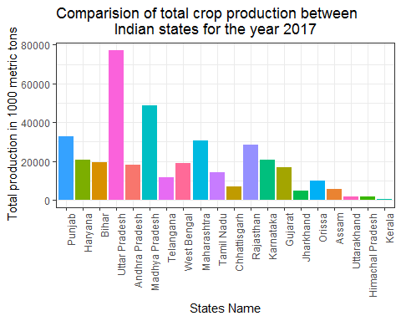
Bar plot
State which produced maximum amount of crops(in metric tons)
For the year 2017

Slide 6
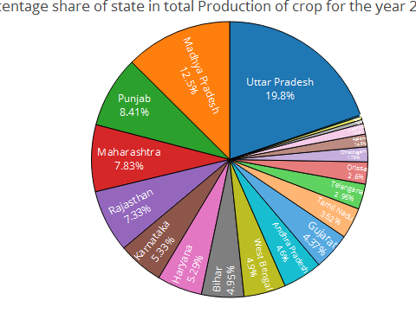
Pie chart
Observations: Uttar Pradesh contributed the maximum crop production for the year 2017 followed by Madhya Pradesh and Punjab.

Slide 7
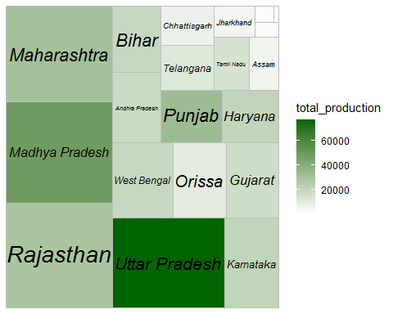
Treemap
Colour intensity shows total production for year 2017, while square size shows area under production

Slide 8
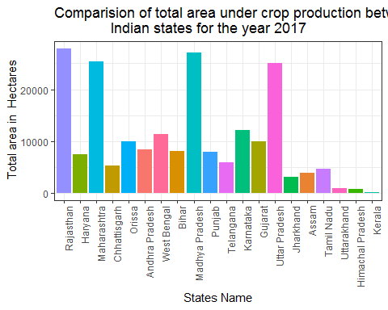
Bar plot
States which have maximum area under prouction of crops for the year 2017

Slide 9
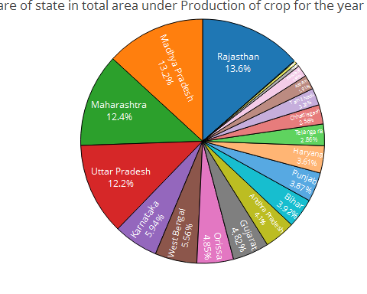
Pie chart
States which have maximum area under production of crops for the year 2017
Observation: Rajasthan has maximum area under production of crops followed by Madhya Pradesh and Maharashtra

Slide 10
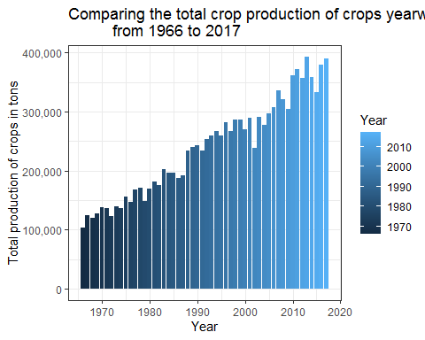
Bar plot
Observation: Total crop production has increased almost 4 times from 1966 to 2017.

Slide 11
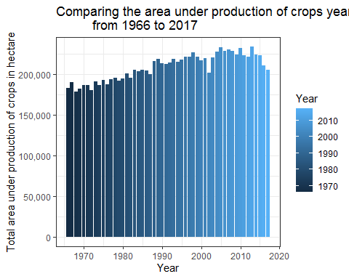
Bar plot
Observation: The area under production of crops increased gradually from 1966 to 2010 but has been declining rapidly since 2010. Urbanization and industrialization can be one of the reasons for its decline.

Slide 12
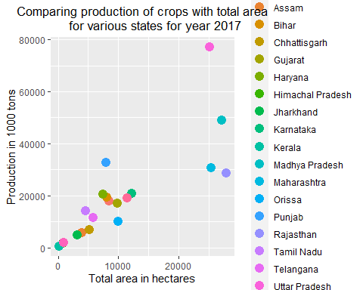
Scatterplot
Comparing the production yield for various states during the year 2017

Slide 13
observation:
Production of crops increases almost linearly with the increase in area.States such as Rajasthan, Odisha have very low yield output. Punjab has very high yield output because of use of modern techniques

Slide 14
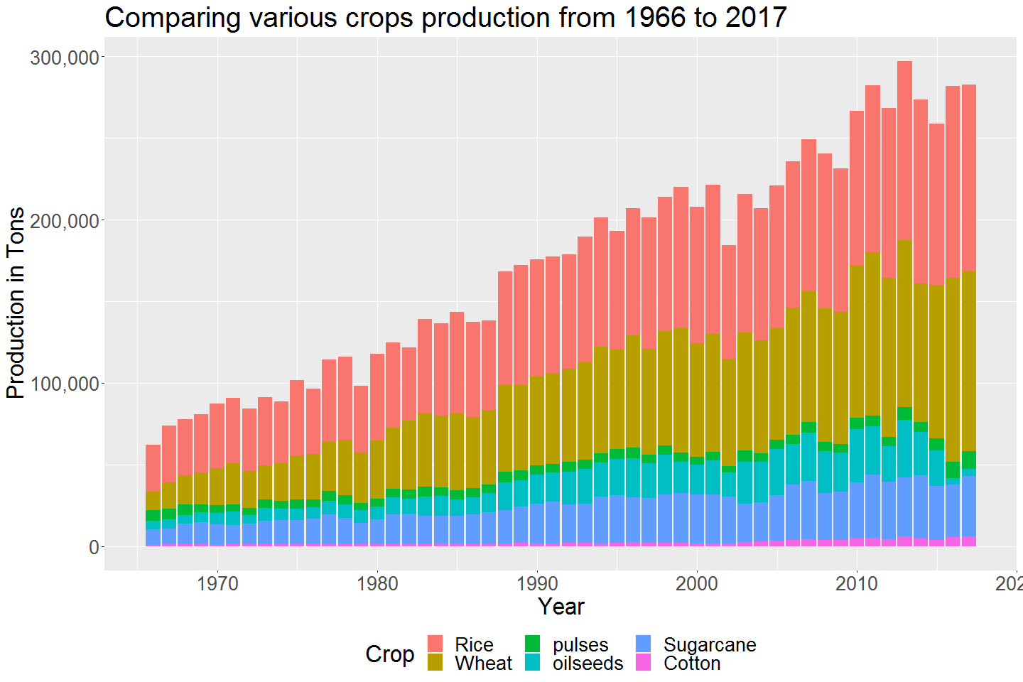
Stacked barplot

Slide 15
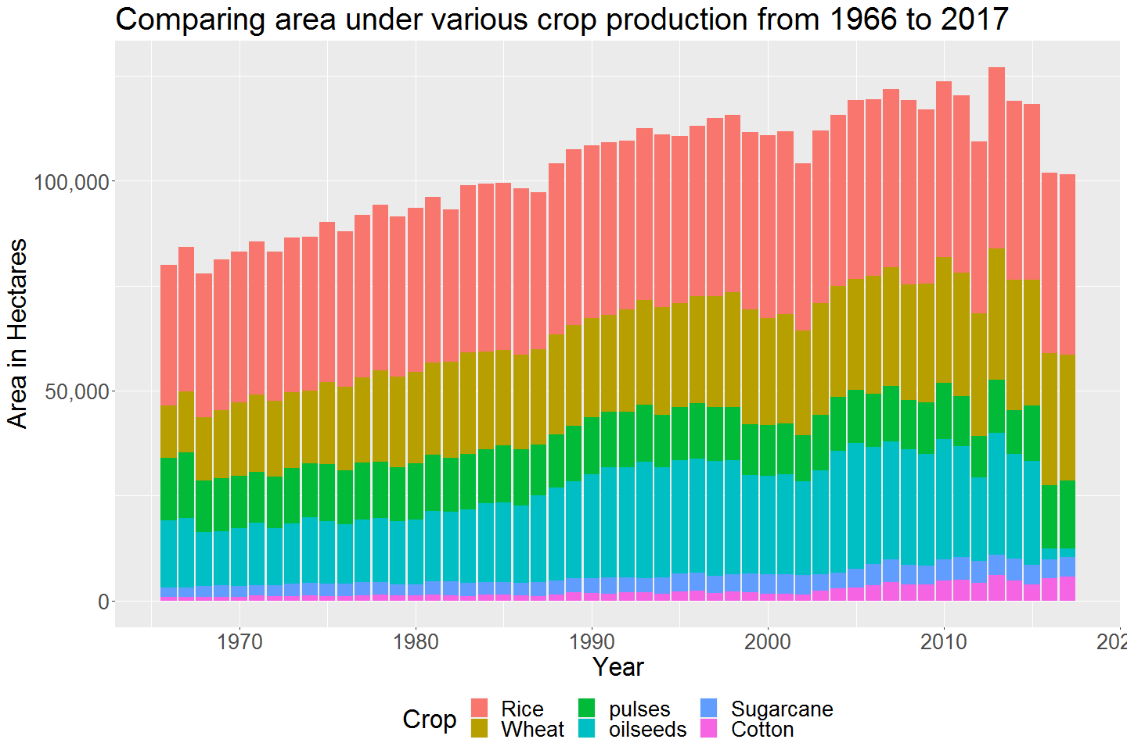
Comparing area under various crop prouction from 1966 to 2017

Slide 16
Observation: Area under wheat and rice has remain constant. There is sharp decline in the area under oilseeds in the last decade.

Slide 17
Conclusion:
One pattern is seen among the farmers from the above visualization.
Most of the farmers rely on traditional crops like wheat and rice.
They tend to avoid growing oilseeds mainly because of its low productivity yield and high competition from the international market.
India imports large quantity of edible oil such as soyabean oil and Palm oil from neighbouring countries.
Government can provide subsidies to the farmer for growing such crops which will help curb imports on such items and also provide farmers new opportunities.
This will be a win-win situation for both Indian Economy and the farmers.

Slide 18
Observation: It is seen that there is continuous rise in the production of staple crop like wheat and rice. On the other hand, production of oil seeds and pulses has been declining gradually. Production of sugarcane and cotton has been constant over the years.

